Slide 1
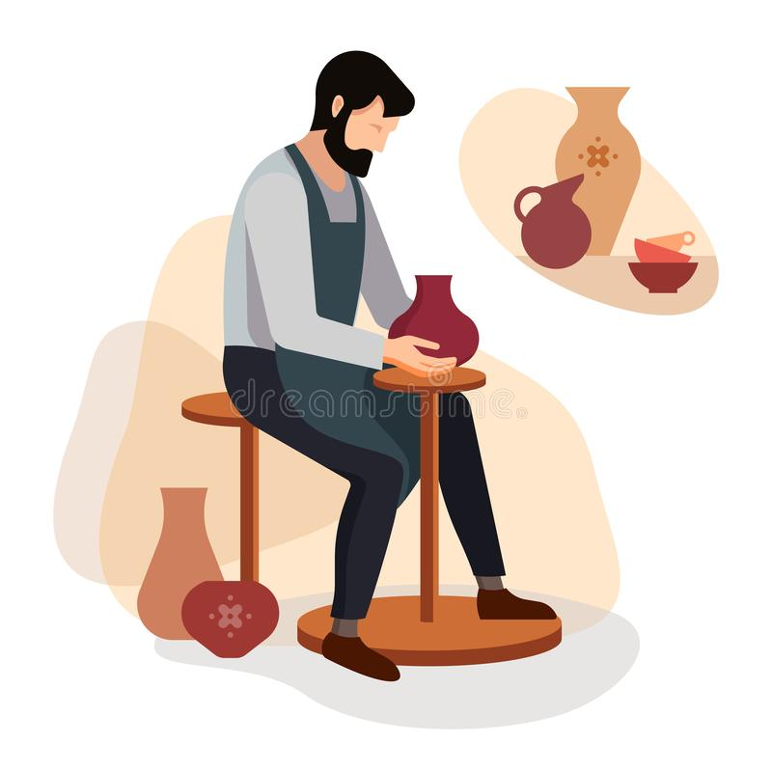

E-EMPORIUM FOR CRAFTSMEN
PRESENTED BY:
SOWMIYA.R(2019PECCS194)
SREE LIKITHAA.P
(2019PECCS196)

Slide 2
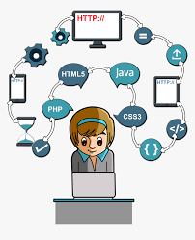
WEB DEVELOPMENT
A MULTI-VENDOR E-EMPORIUM website assist to sell products directly to customers and can assist to earn profit by inviting different vendors to sell their products on website. It has been seen that people mostly search for a website where they can get different products under one roof. This increases the demand for a multi-vendor shopping cart system which helps a customer to access multiple vendor at a time. The opportunity of analyzing the pricing related to different products of different vendors will helps a multivendor store to shine up in the ecommerce market easily.

Slide 3

ABSTRACT
Craftsmen are the group of people who are skilled in making handmade products . Since they are small in numbers there is no particular way to enlarge their business. This MULTI-VENDOR E-EMPORIUM is specially developed for them to sell their products via Internet.

Slide 4

EXISTING SYSTEM
The existing system like amazon , flipkart ,etc., also sell handmade products but there exists intermediate party in business transactions.
Every time if the user has a query about products , delivery, etc., they are redirected to another page known as help and support.

Slide 5

PROPOSED SYSTEM
The proposed system solves the third party problem in this emporium the craftsmen themselves can sell their products.
The proposed system also has embedded chatbot to solve small queries rather redirecting to another page.

Slide 6

TECH STACK
The technological tools used to develop this e-emporium are HTML,CSS,JS and DJANGO.
HTML,CSS and JS are used to create front-end of the web store.
DJANGO is python based web framework used to develop back-end to the web store and SQLITE as database.
Google dialogflow is used to create chatbot to web store.

Slide 7
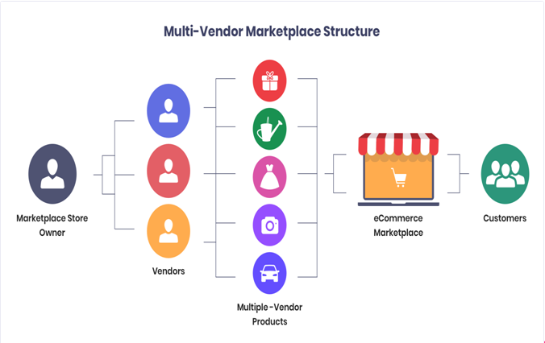
BLOCK DIAGRAM

Slide 8

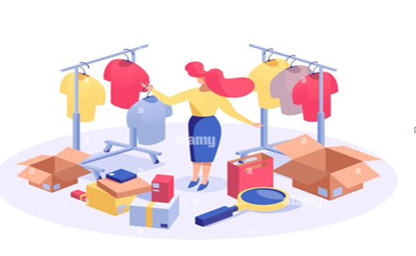
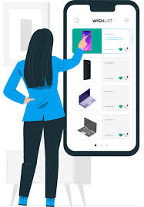
PROJECT MODULES
SUPER ADMIN:
Manage Category
Manage Products
Manage Users
Manage Orders
PRODUCT VENDORS:
Add Products
Update Profile
Gets Notification When an Order is made by Users
Get Orders and Manage Them
USERS:
Add to Cart
Pay with Debit/Credit Card and Order
While Checkout, User should give the address to deliver
Get Email Notification about the confirmation of the order

Slide 9
THANK YOU

